Slide 1
PARIS 2019
Resurfacing Project
March 17, 2020

Slide 2
PARIS 2019 (1741-1988)
RESURFACING PROJECT
JANUARY 15, 2020: PARIS 2019 Project Advertised
FEBRUARY 5, 2020: Bid Opening (5 Bids received)
Matich Corporation lowest responsive bidder
STAFF RECOMMENDATION: Council award $10,765,000 contract to Matich

Slide 3
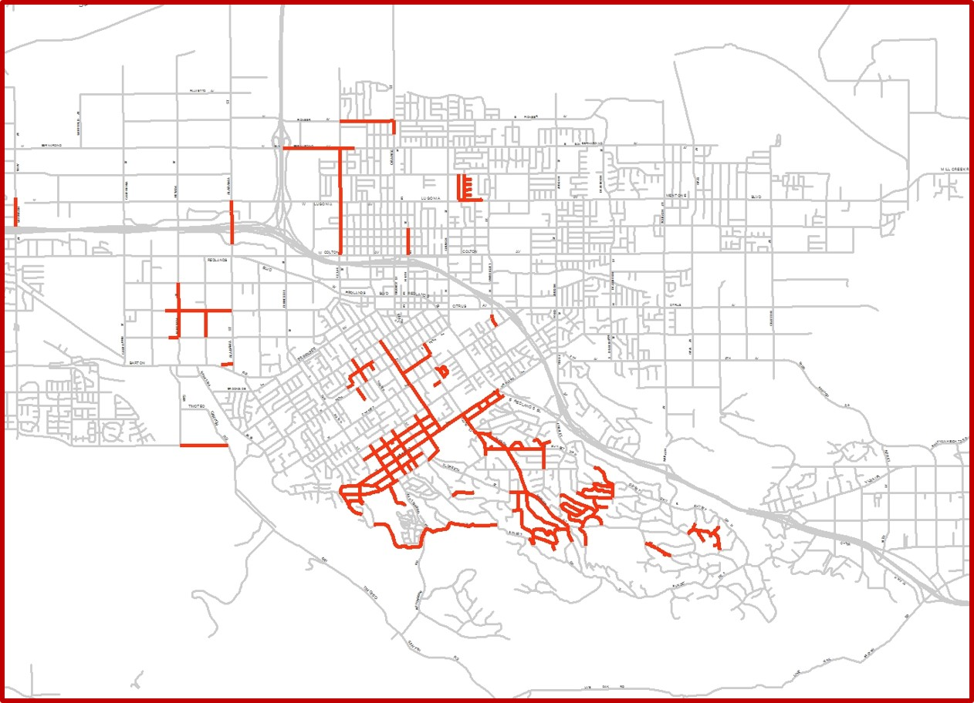
PARIS 2019 (57 LANE MILES)
PARIS 2019

Slide 4
PARIS PROGRAM SINCE 2012
CITY OVERALL STREET SYSTEM:
  650 total lane miles
  300 street miles
PARIS GOAL:
  Resurface 2/3 of City streets within 5 phases/years
PARIS PROJECT COMPLETION (POST-2019 PROJECT):
  440 lane miles resurfaced
  2/3 City streets resurfaced
FUTURE PAVEMENT MANAGEMENT PROGRAM (PMP):
  140 lane miles to be resurfaced
  First 2/3 to be maintained

Slide 5
PARIS
STREET REHABILITATION STRATEGIES
FIVE METHODS OF STREET REHABILITATION:
  Slurry Sealing
  Grind and Overlay
  Remove and Replace
  Full Depth Reclamation with Mechanical Stabilization
  Full Depth Reclamation with Cement Stabilization

Slide 6
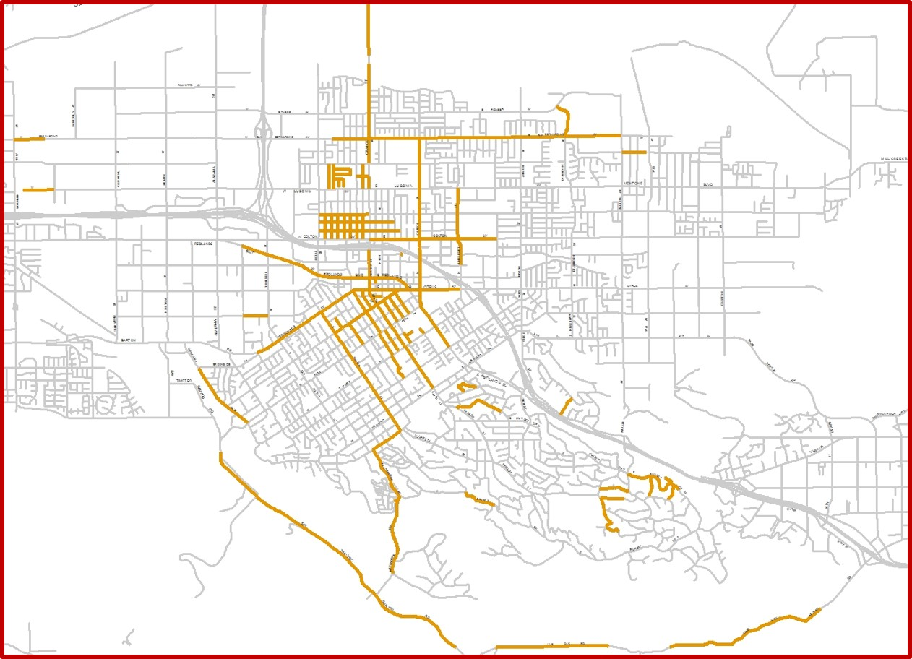
PRE-PARIS 2007-2012 (70 LANE MILES)
PRE-PARIS

Slide 7
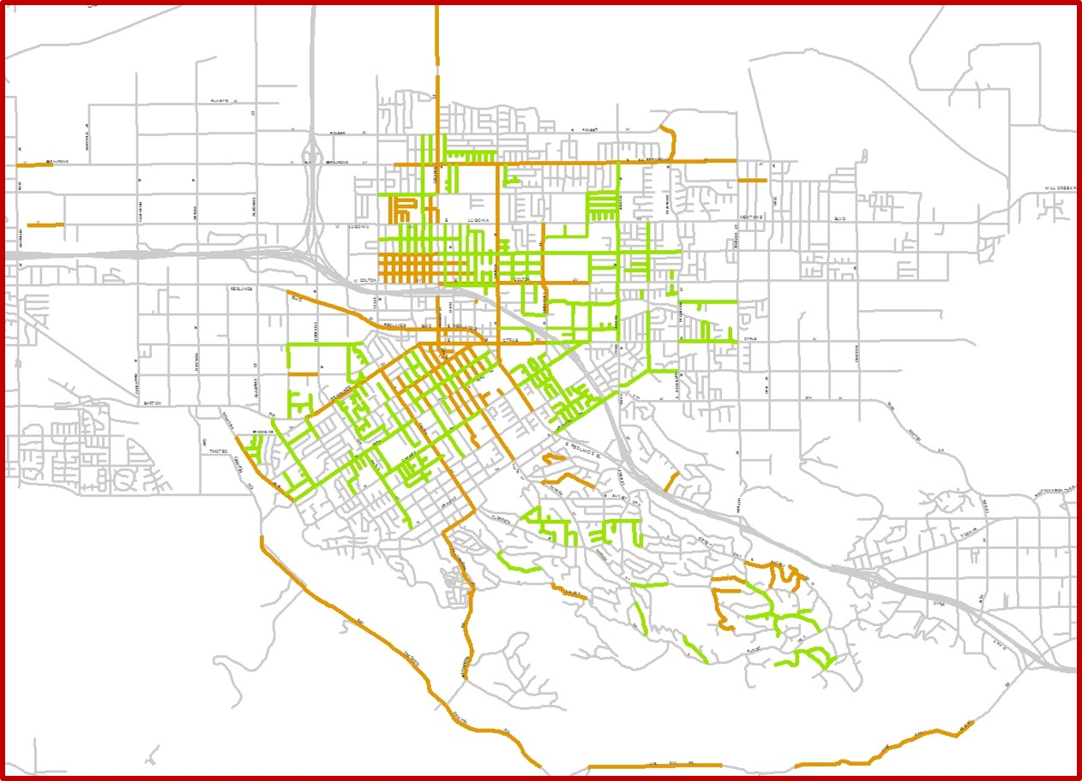
PARIS 2013 (112 LANE MILES)
PARIS 2013
PRE-PARIS

Slide 8
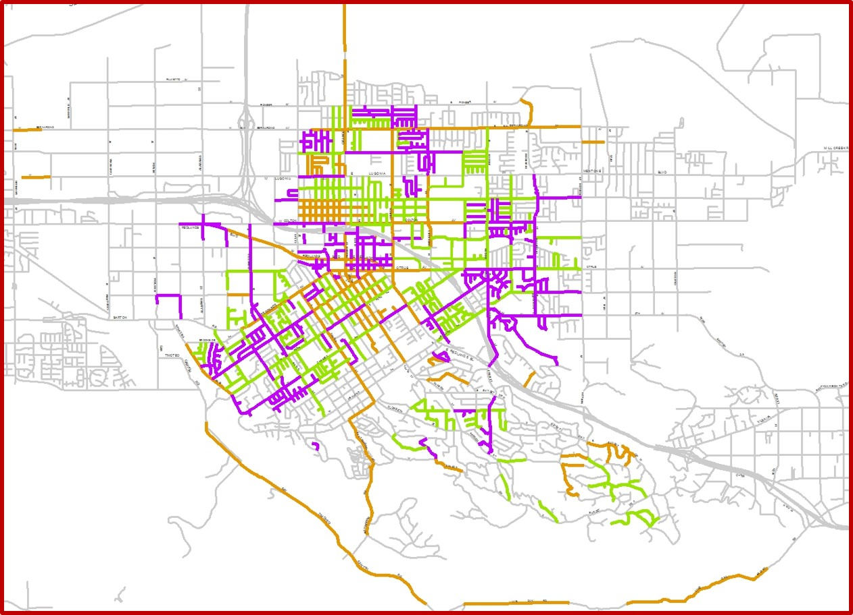
PARIS 2014 (102 LANE MILES)
PARIS 2014
PARIS 2013
PRE-PARIS

Slide 9
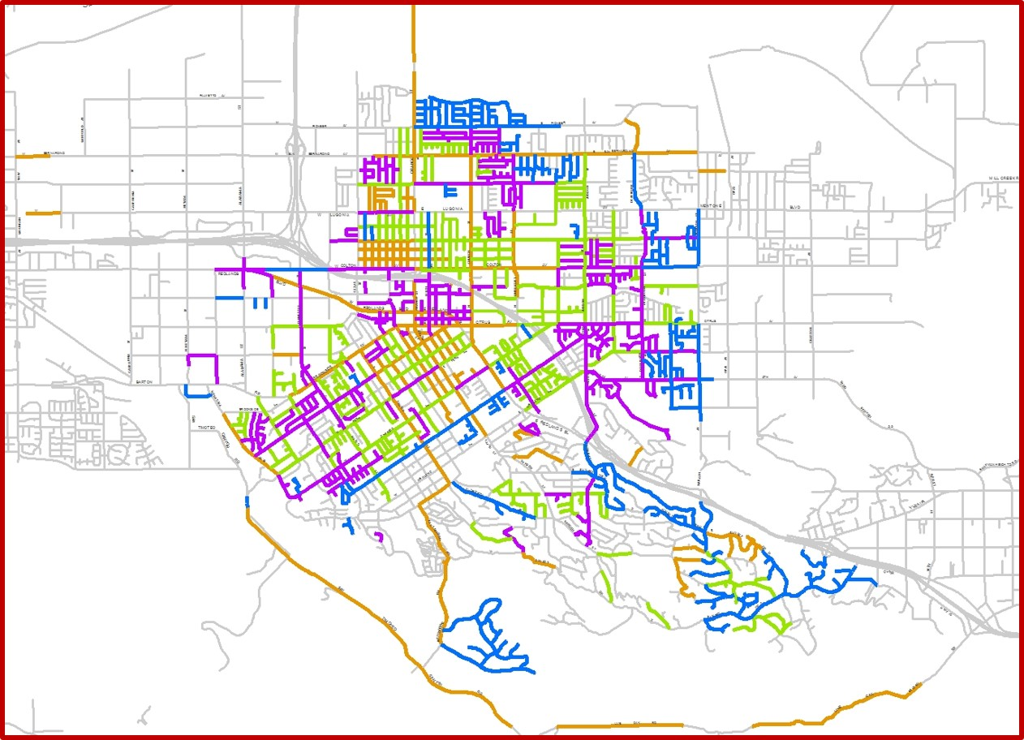
PARIS 2015 (112 LANE MILES)
PARIS 2015
PARIS 2014
PARIS 2013
PRE-PARIS

Slide 10
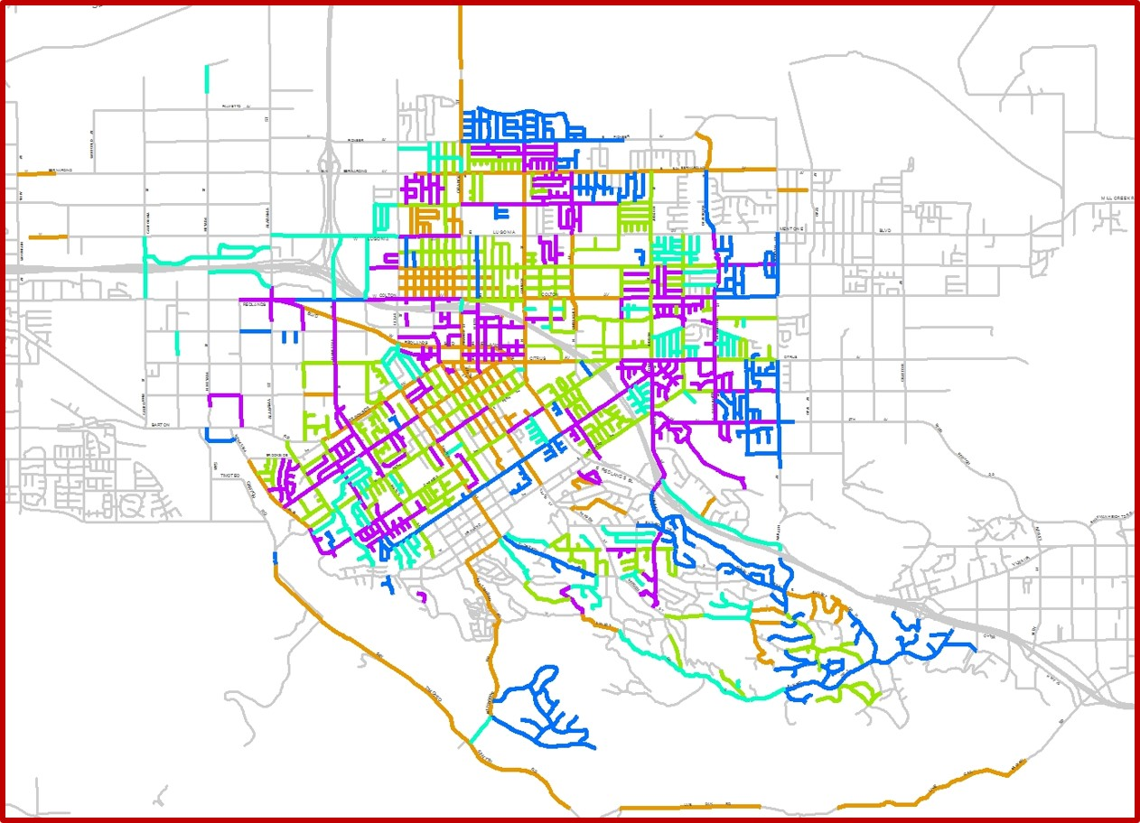
PARIS 2017 (57 LANE MILES)
PARIS 2017
PARIS 2015
PARIS 2014
PARIS 2013
PRE-PARIS

Slide 11
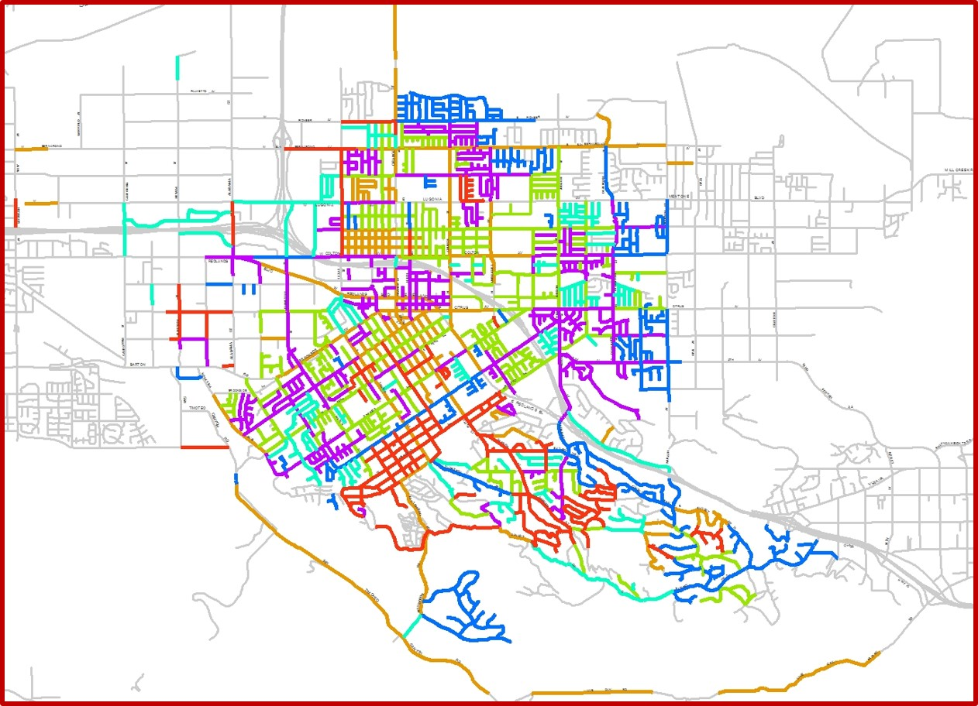
PARIS 2013 – 2019 (440 LANE MILES)
PARIS 2019
PARIS 2017
PARIS 2015
PARIS 2014
PARIS 2013
PRE-PARIS

Slide 12
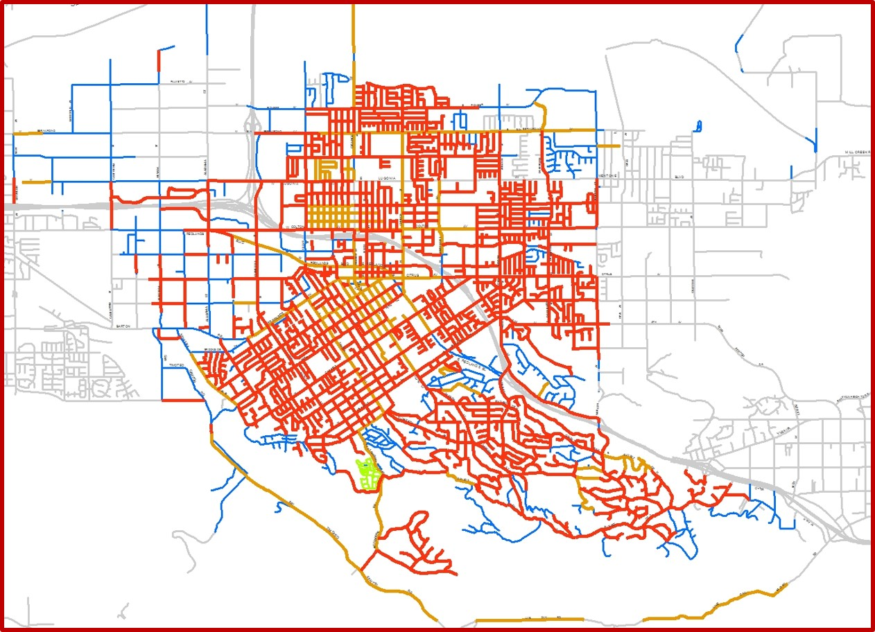
PRE-PARIS to PARIS to FUTURE PMP

Slide 13

CITY COUNCIL QUESTIONS?

